Slide 1
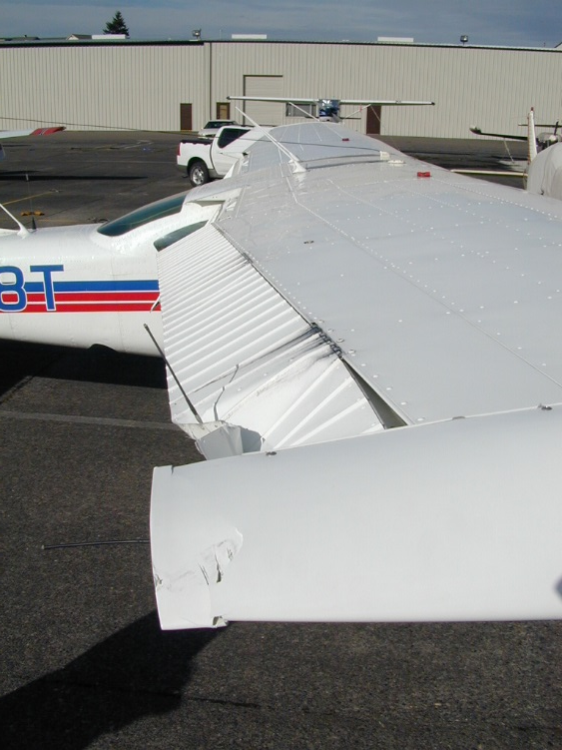

Understanding Airworthiness
Howard Wolvington
ATP, Gold Seal CFI-CFII-MEI ASEL/ASES/AMEL
2014 National CFI of the Year
Designated Pilot Examiner
http://flywithhoward.com/resources/

Slide 2
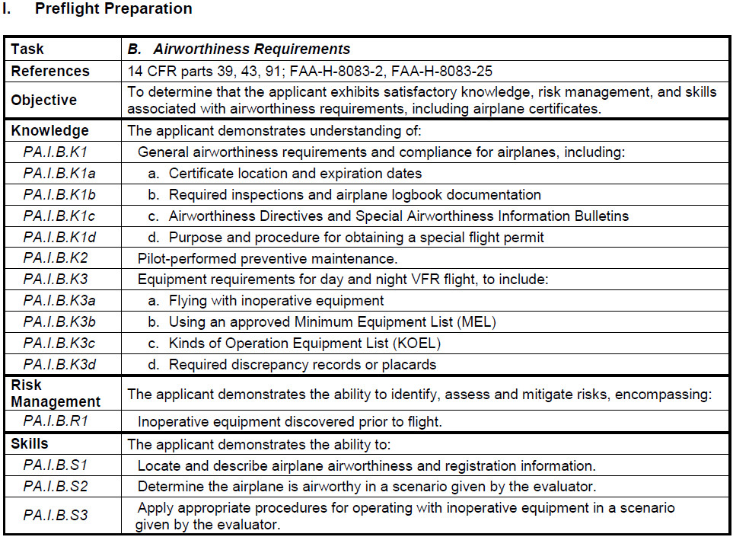
Airman Certification Standards
Private Pilot: FAA-S-ACS-6B

Slide 3
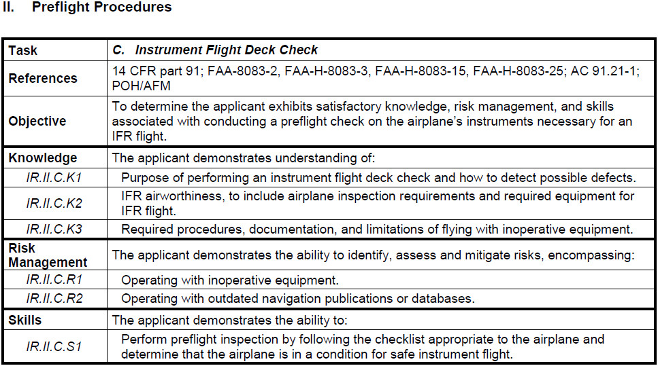
Airman Certification Standards
Instrument Rating: FAA-S-ACS-8B

Slide 4
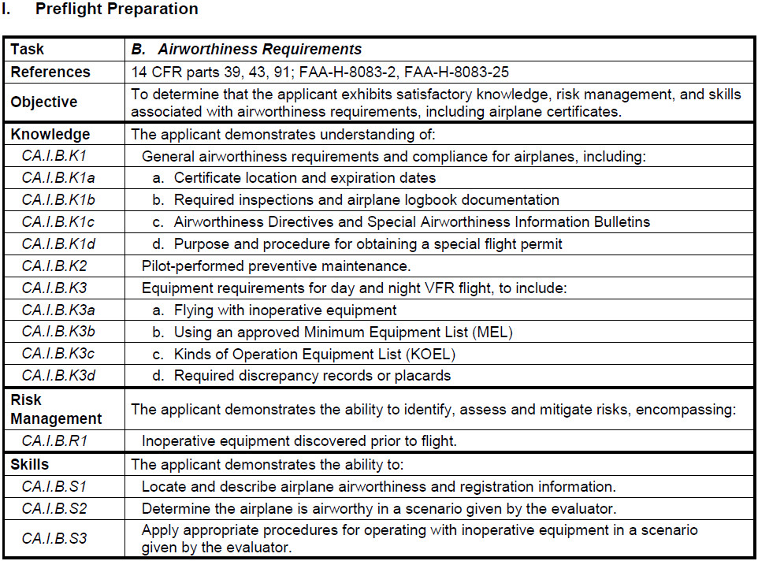
Airman Certification Standards
Commercial Pilot: FAA-S-ACS-7A

Slide 5
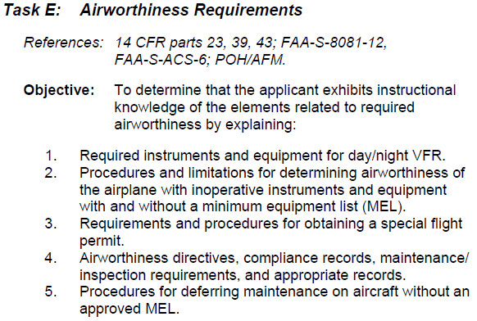
Practical Test Standards
Flight Instructor: FAA-S-8081-6D (AOA III. Preflight Preparation)

Slide 6
FAA References
91.7 Civil aircraft airworthiness
91.205 Instrument and equipment requirements
91.207 Emergency locator transmitters
91.213 Inoperative instruments and equipment
91.403 General
91.405 Maintenance required
91.407 Operation after maintenance, preventive maintenance, rebuilding, or alteration
91.409 Inspections
91.411 Altimeter system and altitude reporting equipment tests and inspections
91.413 Transponder tests and inspections
AC 91-67 Minimum Equipment Requirements for General Aviation operations under Part 91 (withdrawn on 11/3/2017 pending a revision to “align with ICAO guidance”)

Slide 7
FAA Context
The regulations are written by lawyers and are interpreted by case law
The regulations do not:
  Need to be clear or easy to interpret
  Need to be logical nor make sense
  Need to be convenient for pilots
The regulations do:
  Need to be followed to avoid FAA enforcement action (ramp inspection or accident/incident investigation, miscellaneous oversight activities)
  Need to be understood to pass a Practical Test for a Certificate or Rating
  Need to be explained by CFIs to student pilots prior to solo
  Need to be demonstrated by example by CFIs during training

Slide 8
Where to Start?
Review the Regulations in the following order:
91.7 Civil aircraft airworthiness
91.403 General
91.405 Maintenance required
91.205
91.213

Slide 9
91.7 Civil Aircraft Airworthiness
91.7 Civil aircraft airworthiness
No person may operate a civil aircraft unless it is in an airworthy condition.
The PIC of a civil aircraft is responsible for determining whether that aircraft is in condition for safe flight. The PIC shall discontinue the flight when unairworthy mechanical, electrical, or structural conditions occur.
The definition of the word "Airworthy" was never included in the Code of Federal Regulations until the 14 CFR Part 3 which defined “Airworthy” as, the aircraft conforms to its type design and is in a condition for safe flight.
While an A&P with Inspection Authority determines the airworthiness of an aircraft at the annual inspection, the pilot who is PIC, determines the airworthiness of the aircraft at all other times. This includes the Preflight Inspection, at Takeoff, and during the flight. The PIC must do so per the applicable regulations.
If an unairworthy condition occurs during flight, the PIC must land at the nearest suitable airport, and may not continue to the original destination (Case Study, AOPA Legal report on Airline diversion for convenience)

Slide 10
91.403 General (& AD reference)
91.403 (a) The owner or operator of an aircraft is primarily responsible for maintaining that aircraft in an airworthy condition, including compliance with part 39 of this chapter.
39.1 Purpose of this regulation.
The regulations in this part provide a legal framework for FAA's system of Airworthiness Directives.
39.7 What is the legal effect of failing to comply with an airworthiness directive?
Anyone who operates a product that does not meet the requirements of an applicable airworthiness directive is in violation of this section.
Airworthiness directives are periodically issued requiring inspection, repair, or replacement of aircraft components in the interest of safety -- often on the basis of accident history

Slide 11
91.405 Maintenance
91.405 each owner or operator of an aircraft –
Shall have that aircraft inspected as prescribed in subpart E of this part and shall between required inspections, except as provided in paragraph (c) of this section, have discrepancies repaired as prescribed in part 43 of this chapter.
(b) …
(c) Shall have any inoperative instrument or item of equipment permitted to be inoperative by 91.213(d)(2) of this part, repaired, replaced, removed, or inspected at the next required inspection; and
(d) When listed discrepancies include inoperative instruments or equipment, shall ensure that a placard has been installed as required by 43.11 of this chapter.
Thus, unless otherwise allowed by the regulations, the FAA expects all installed instruments and equipment on the airplane to be working!
We can takeoff and fly with certain instruments and equipment inoperative if and only if we meet the explicit requirements of 91.213. Otherwise, anything that is inoperative must be “fixed” before flight.

Slide 12
91.205 What Instruments & Equipment are Always Required?
Day VFR (A TomatoFlames F) should be memorized with some aid:
  Anti-collision light system
  Tachometer (for each engine)
  Oil pressure gauge (for each engine using pressure system)
  Manifold pressure (for each “altitude” engine – i.e. turbocharged, etc.)
  Airspeed Indicator
  Temperature gauge (for each liquid-cooled engine)
  Oil temperature gauge (for each air-cooled engine)
  Fuel quantity gauge (for each fuel tank)
  Landing gear position indicators (if retractable gear)
  Altimeter
  Magnetic direction indicator
  Elt
  Safety belts and harnesses
  Flotation gear (if operated for hire over water beyond power-off gliding distance from shore)

Slide 13
91.205 What Instruments & Equipment are Always Required?
Night VFR (Flaps) should be memorized with some aid:
  All day VFR equipment
  Fuses
  Landing light (if for hire)
  Anti collision lights (all aircraft)
  Position lights (red/green/white)
  Source of electrical energy for all installed electrical and radio equipment

Slide 14
What is in 91.213 Inoperative Instruments and Equipment?
An aircraft may be “airworthy” but have some instrument or equipment that has become inoperative. If in flight, the flight may continue if the item is not in 91.205 for the applicable type of flight, and not required by the aircraft type certificate. However, there are further restrictions with respect to take off with something inoperative!
Except as provided in paragraph (d) of this section, no person may take off an aircraft with inoperative instruments or equipment installed unless the following conditions are met:
  An approved Minimum Equipment List [MEL] exists for that aircraft.
  The aircraft has within it a letter of authorization [LOA], issued by the FSDO having jurisdiction over the area in which the operator is located, authorizing operation of the aircraft under the MEL. The LOA may be obtained by written request of the airworthiness certificate holder. The MEL and the LOA constitute a supplement type certificate for the aircraft.
  The approved MEL must-
  (i) Be prepared in accordance with the limitations specified in paragraph (b) of this section; and
  (ii) Provide for the operation of the aircraft with the instruments and equipment in an inoperable condition
  The aircraft records available to the pilot must include an entry describing the inoperable instruments and equipment.
  The aircraft is operated under all applicable conditions and limitations contained in the MEL and the LOA

Slide 15
91.213(a-c) With a MEL
(b) The following instruments and equipment may not be included in the MEL:
  Instruments and equipment that are either specifically or otherwise required by the airworthiness requirements under which the aircraft is type certificated and which are essential for safe operations under all operating conditions.
  Instruments and equipment required by an AD to be in operable conditions unless the AD provides otherwise.
  Instruments and equipment required for specific operations by this part.
(c) A person authorized to use an approved MEL issued for a specific aircraft under subpart K of this part, part 121, 125, or 135 of this chapter must use that MEL to comply with the requirements in this section

Slide 16
91.213(a-c) With a MEL
A MEL is normally used for Air Carrier operations (Part 121 and 135) and for aircraft that have turbine engines.
The MEL is constructed from a Master Minimum Equipment List (MMEL) that is provided by the aircraft manufacturer. The MEL, which is tail number specific, is proposed by the aircraft owner/operator and then approved by the local FSDO with respect to the nature of the aircraft owner’s operations.
Available MMELs are available on an FAA web site:
http://fsims.faa.gov/PICResults.aspx?mode=Publication&doctype=MMEL
There is a generic MMEL posted for “Single Engine Airplane” – 11/23/2011
https://fsims.faa.gov/PICDetail.aspx?docId=M%20SE%20Airplane%20R1

Slide 17
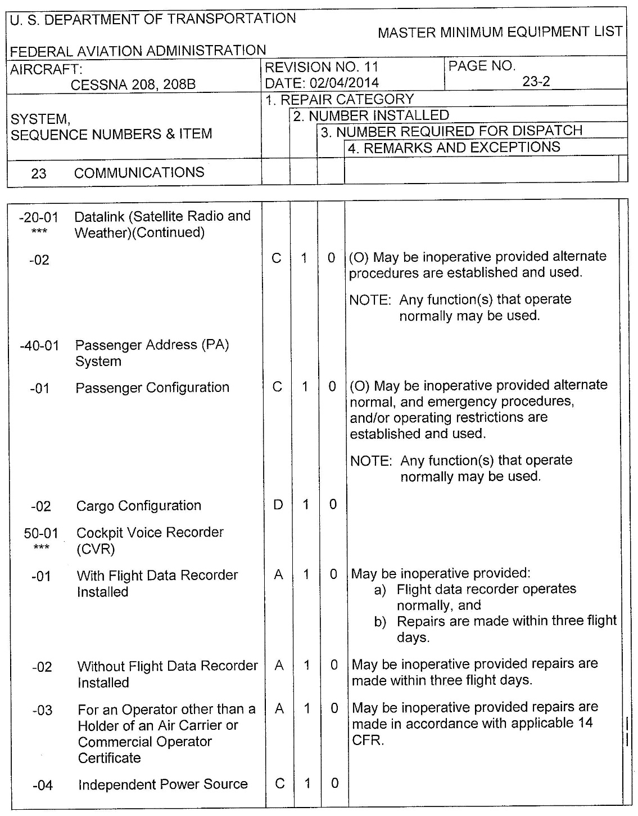
Example MMEL/MEL page

Slide 18
91.213(a-c) With a MEL
Most piston single engine aircraft do not have an approved MEL.
Therefore, without a MEL, the only way to take off in an aircraft with inoperative equipment is via the provisions of paragraph (d) of 91.213, or a Special Flight Permit

Slide 19
91.213(d) Without MEL
Without a MEL, four conditions must be all satisfied to takeoff with inoperative instruments or equipment under 91.213(d)
Type of aircraft
Type of inoperative instruments or equipment
Action: Remove or Deactivate, and then Placard as Inoperative
Determination of Safety by Pilot or Mechanic

Slide 20
91.213(d) Without MEL
Four conditions must all be satisfied to takeoff with inoperative instruments or equipment under 91.213(d)
(1) [Type of aircraft]
The flight operation is conducted in a
(i) Rotorcraft, non-turbine-powered airplane, glider, lighter than-air aircraft, powered parachute, or weight-shift-control aircraft for which a Master Minimum Equipment List has not been developed
(ii) Small rotorcraft, non-turbine-powered airplane, glider or lighter-than-air aircraft for which a Master Minimum equipment List has been developed;
For airplanes, the criteria is satisfied if the airplane is not turbine powered and either has no MMEL, or is less than 12,500 pounds (small) – e.g. most single engine piston aircraft. As an example, a turbine power Cessna Caravan would never qualify under this condition.

Slide 21
91.213(d) Without MEL
Four conditions must all be satisfied to takeoff with inoperative instruments or equipment under 91.213(d)
(2) [Type of inoperative instruments or equipment]
(2) The inoperative instruments and equipment are not-
(i) Part of the VFR-day type certification instruments and equipment prescribed in the applicable airworthiness regulations under which the aircraft was type certificated;
(ii) Indicated as required on the aircraft’s equipment list, or on the Kinds of Operations Equipment List for the kind of flight operation being conducted;
(iii) Required by 91.205 or any other rule of this part for the specific kind of flight operations being conducted; or
(iv) Required to be operational by an airworthiness directive;
Items (iii) and (iv) are easily understood, but items (i) and (ii) may require further explanation

Slide 22
91.213(d) Without MEL
Four conditions must all be satisfied to takeoff with inoperative instruments or equipment under 91.213(d)
(2) [Type of inoperative instruments or equipment]
(2) The inoperative instruments and equipment are not-
(i) Part of the VFR-day type certification instruments and equipment prescribed in the applicable airworthiness regulations under which the aircraft was type certificated
For most Cessna aircraft, the equipment list indicates which instruments and equipment are required by the VFR-day type certification by a code on the equipment list

Slide 23
91.213(d) Without MEL

Slide 24
91.213(d) Without MEL

Slide 25
91.213(d) Without MEL
Four conditions must all be satisfied to takeoff with inoperative instruments or equipment under 91.213(d)
(2) [Type of inoperative instruments or equipment]
(2) The inoperative instruments and equipment are not-
(ii) Indicated as required on the aircraft’s equipment list, or on the Kinds of Operations Equipment List for the kind of flight operation being conducted;
For many newer aircraft, such as a CIRRUS, the manufacture provides a Kinds of Operations Equipment List and it will be found in the Limitation section of the AFM.

Slide 26
91.213(d) Without MEL

Slide 27
91.213(d) Without MEL

Slide 28
91.213(d) Without MEL
Four conditions must all be satisfied to takeoff with inoperative instruments or equipment under 91.213(d)
(3) [Remove or Deactivate, and then Placard]
(3) The inoperative instruments and equipment are-
(i) Removed from the aircraft, the cockpit control placarded, and the maintenance recorded in accordance with 43.9 of this chapter; or
(ii) Deactivated and placarded “Inoperative”. If deactivation of the inoperative instruments or equipment involved maintenance, it must be accomplished and recorded in accordance with part 43 of this chapter;
Thus, action is required by a pilot or mechanic with respect to the item that is inoperative. It might be a maintenance action to remove the equipment and update the maintenance logs, with a placard of any control, or it might be action by the pilot to deactivate the equipment and then to placard it.

Slide 29
91.213(d) Without MEL
Four conditions must all be satisfied to takeoff with inoperative instruments or equipment under 91.213(d)
(3) [Remove or Deactivate, and then placard]
Deactivate: Webster’s Dictionary: Definition of deactivate, transitive verb: to make inactive or ineffective
Deactivation (AC 91-67): “Deactivation means to make a piece of equipment or an instrument unusable to the pilot/crew by preventing its operation”
Examples (placard required in every case…):
An inoperative panel lighting system could be deactivated by a mechanic disconnecting the wiring to the system (and would require a logbook entry)
An inoperative landing light could be deactivated by a pilot turning off the switch
A radio could be deactivated by a pilot turning off the power switch
An autopilot could be deactivated by a pilot pulling the circuit breaker
A directional gyro (or CDI) could be deactivated by covering the instrument so that it can not be referenced by the pilot/crew
An inoperative EGT gauge, could be deactivated by covering the instrument so that it can not be referenced by the pilot/crew

Slide 30
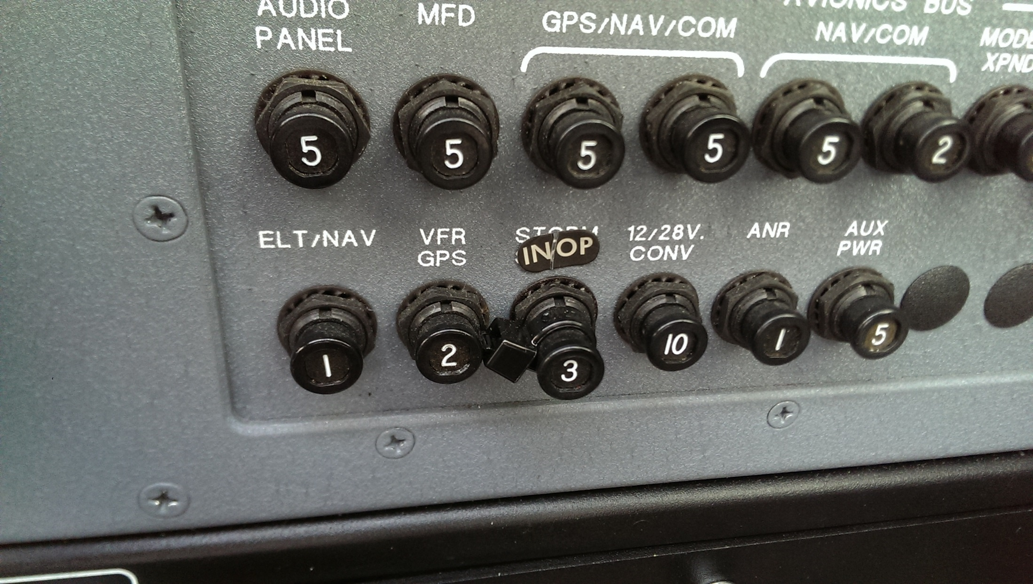
91.213(d) Without MEL

Slide 31
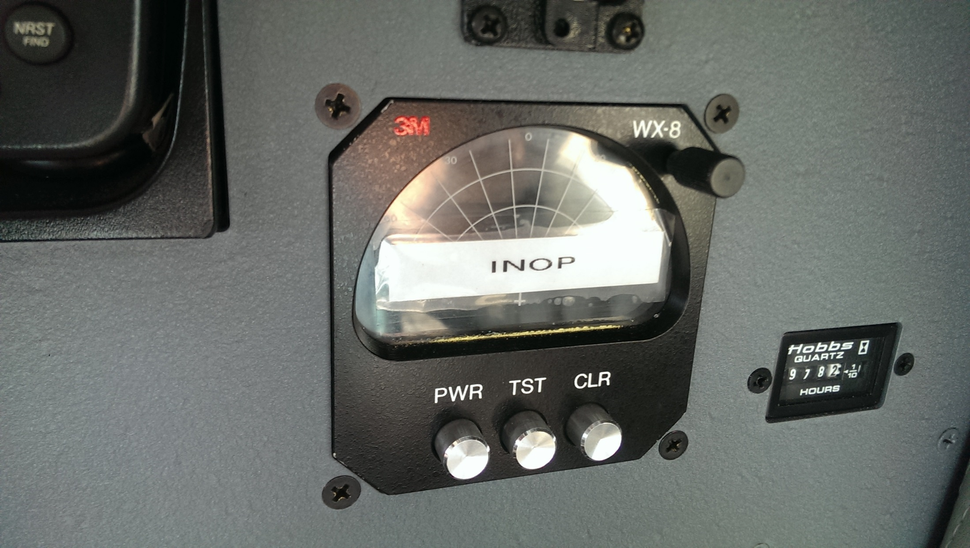
91.213(d) Without MEL

Slide 32
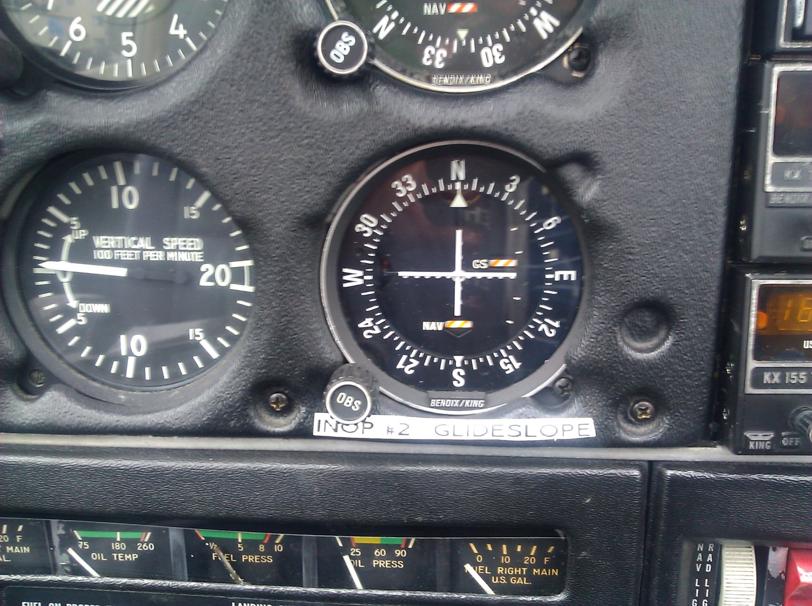
91.213(d) Without MEL

Slide 33
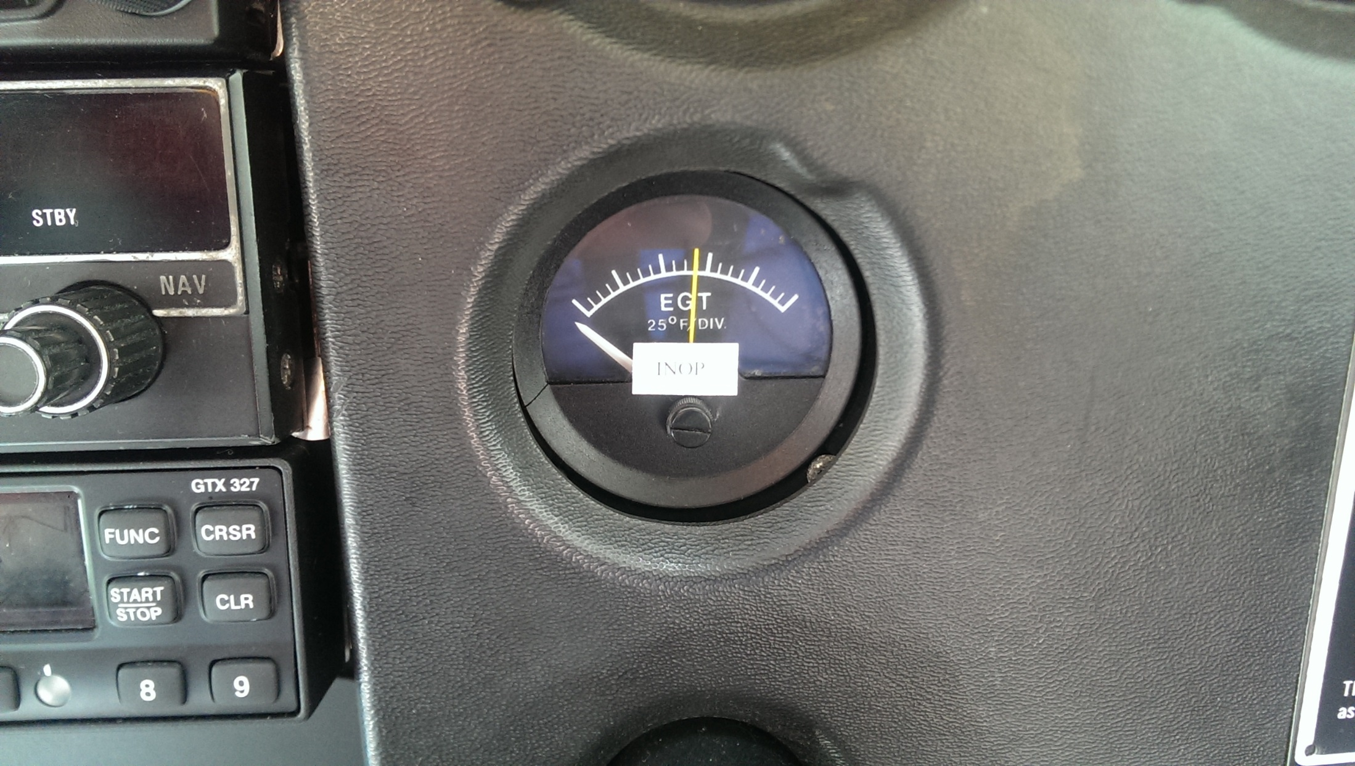
91.213(d) Without MEL

Slide 34
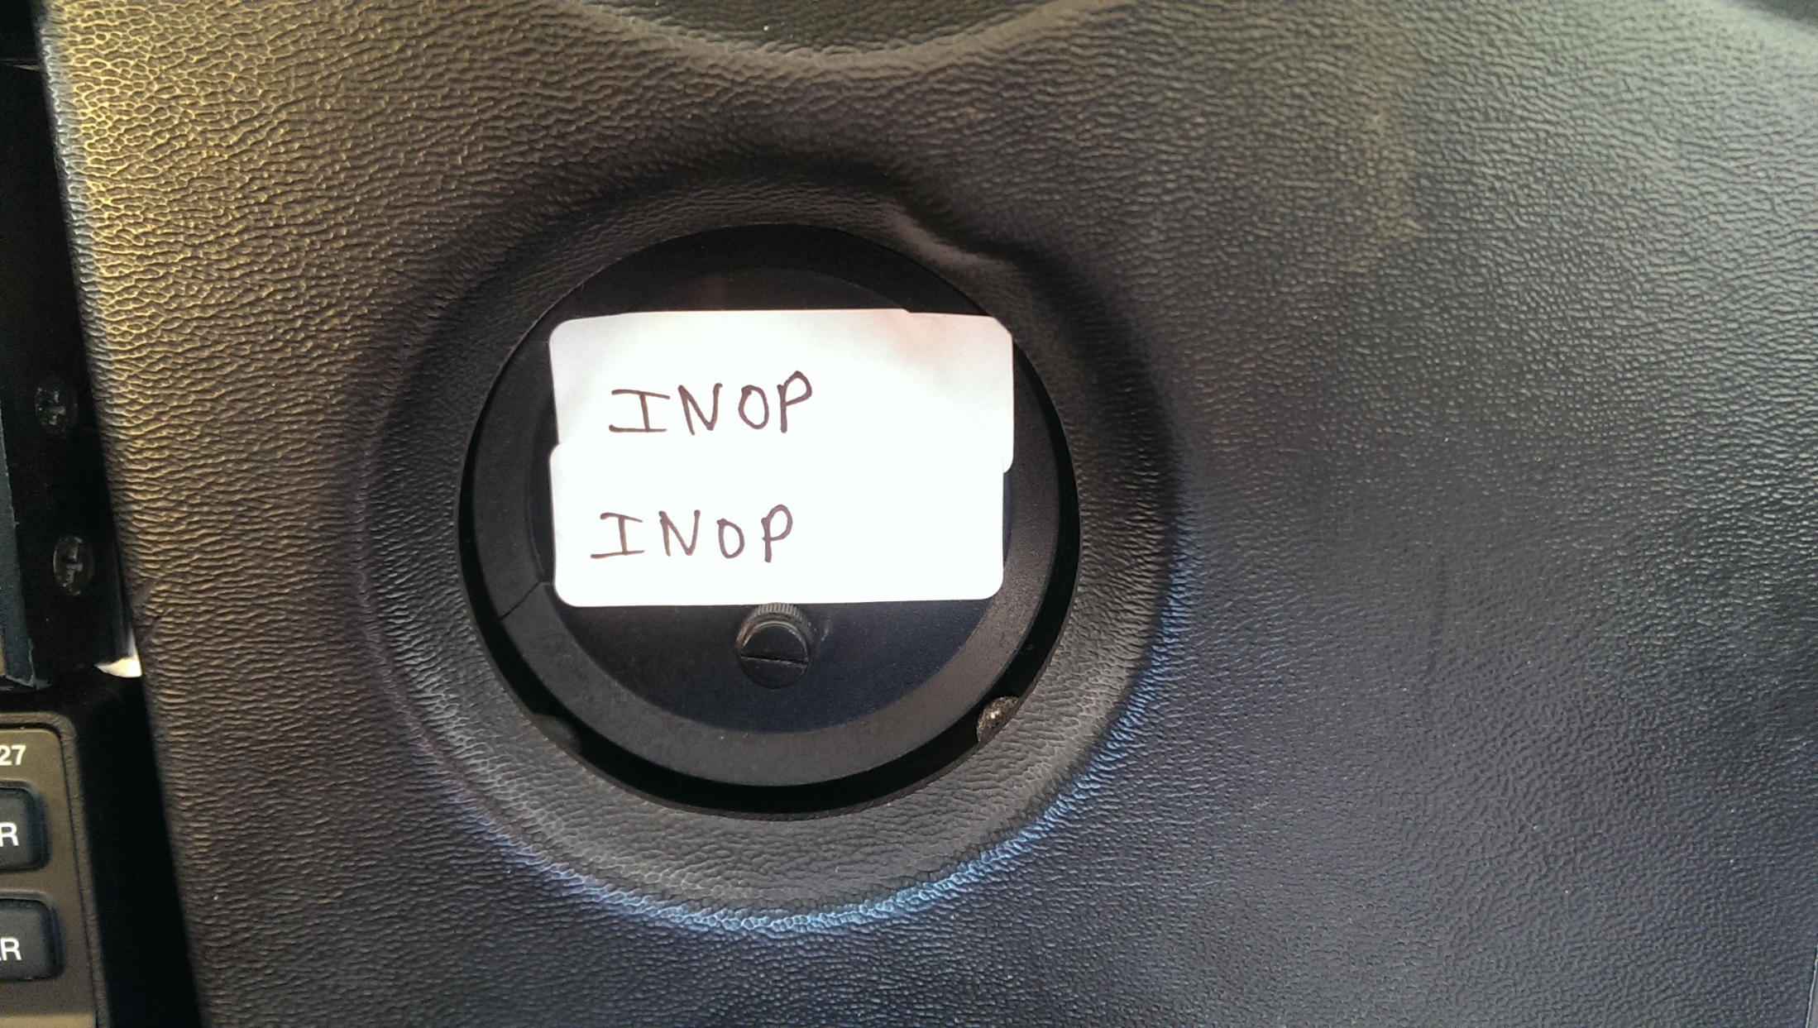
91.213(d) Without MEL

Slide 35
91.213(d) Without MEL
Four conditions must all be satisfied to takeoff with inoperative instruments or equipment under 91.213(d)
(4) [Determination of safety]
(4) A determination is made by a pilot, who is certificated and appropriately rated under part 61 of this chapter, or by a person, who is certificated and appropriately rated to perform maintenance on the aircraft, that the inoperative instrument or equipment does not constitute a hazard to the aircraft.
Note: a pilot might determine that it is safe to fly an aircraft during the day with operational strobes but with an inoperative landing light. However, that same pilot might determine that it is not safe to fly on a dark moonless night if he intended to land at a small airport in a dark area with poor runway lighting.

Slide 36
The Provisions of 91.213(d) are not available operating under Part 121 or 135
§ 91.213 Inoperative instruments and equipment.
(a) Except as provided in paragraph (d) of this section, no person may take off an aircraft with inoperative instruments or equipment installed unless the following conditions are met:
(1) An approved Minimum Equipment List exists for that aircraft.
…
§ 121.628 Inoperable instruments and equipment.
(a) No person may take off an airplane with inoperable instruments or equipment installed unless the following conditions are met:
(1) An approved Minimum Equipment List exists for that airplane.
…
§ 135.179 Inoperable instruments and equipment.
(a) No person may take off an aircraft with inoperable instruments or equipment installed unless the following conditions are met:
(1) An approved Minimum Equipment List exists for that aircraft.
…

Slide 37
91.213(d) Without MEL
The FAA has taken enforcement action for operations not in compliance with the applicable Airworthiness Regulations
Case study (as reported by AOPA General Counsel, 5/1997)
Part 135 day VFR Charter flying a 4 seat Piper Cherokee
Owner/pilot was A&P with IA
Operator did not have an approved MEL
One of 2 Glideslopes was intermittent and placarded as “inoperative”
FAA Inspector noticed and asked about the INOP sticker
Radio/CDI was not deactivated as the pilot wanted to use VOR lateral navigation
FAA determined a violation which was upheld by the NTSB review board
$5,000 fine

Slide 38
91.213(e) Reference to Special Flight Permit
If there is no MEL and the criteria of 91.213(d) can not be satisfied, then the aircraft can take off if and only if a special flight permit is issued under 21.197 and 21.199

Slide 39
Special Flight Permit
21.197 says that a Special Flight Permit may be issued for an aircraft that may not currently meet applicable airworthiness requirements but is capable of safe flight for listed purposes, such as flying to a base where repairs are to be performed
21.199 says that the applicant for a Special Flight Permit must submit a statement indicating
  (1) The purpose of the flight
  (2) The proposed itinerary
  (3) The crew required to operate the aircraft and its equipment
  (4) Any restriction the applicant considers necessary for safe operation of the aircraft
  (5) Any other information considered necessary by the FAA for the purpose of prescribing operating limitations
Application is made via form 8130-6 thru the local Flight Standards District Office (FSDO)

Slide 40
Sample Special Flight Permit

Slide 41
Typical Special Flight Permit Operating Limitations

Slide 42
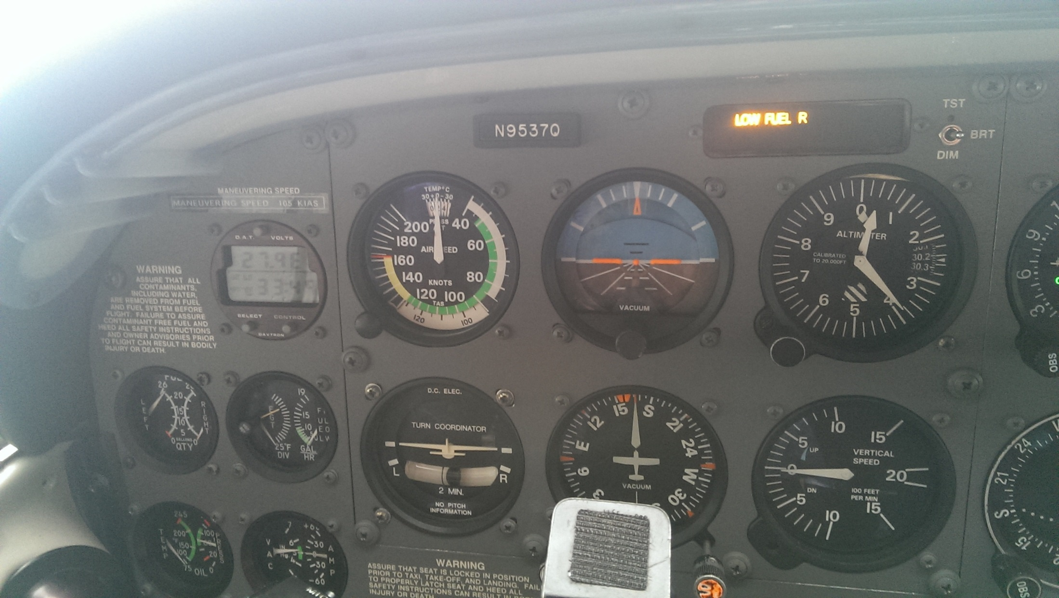
Some Examples of Aircraft Discrepancies
Engine is running on the ground prior to Taxi. What is proper pilot action?

Slide 43
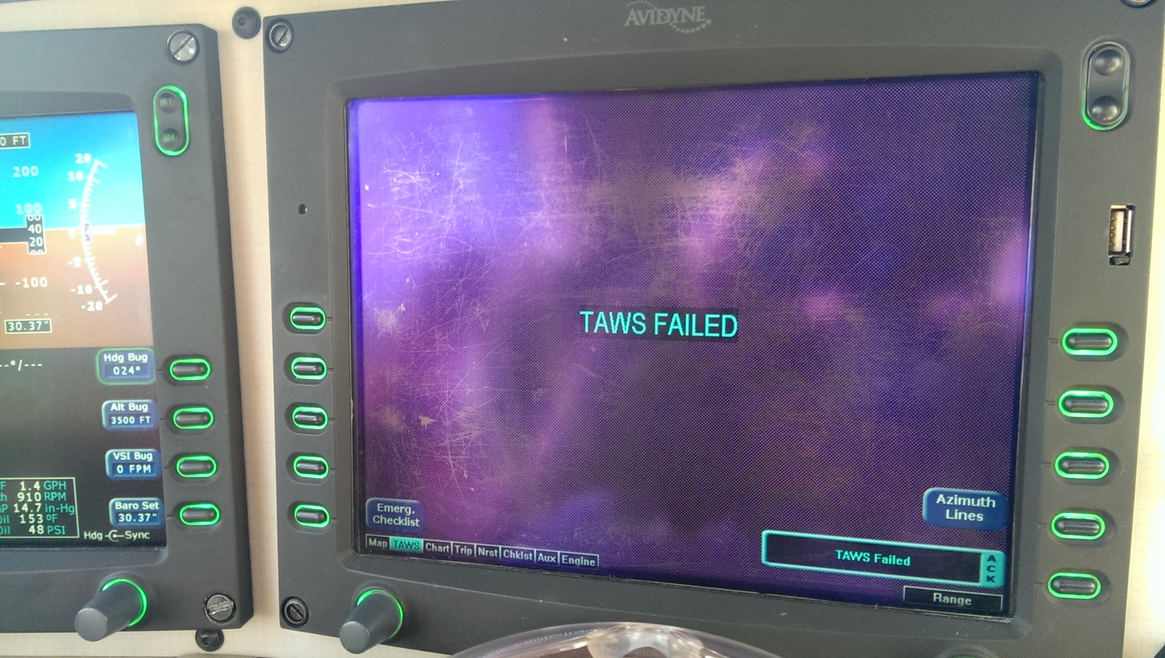
Some Examples of Aircraft Discrepancies
It is obvious that the TAWS is inoperative? Can we takeoff?

Slide 44
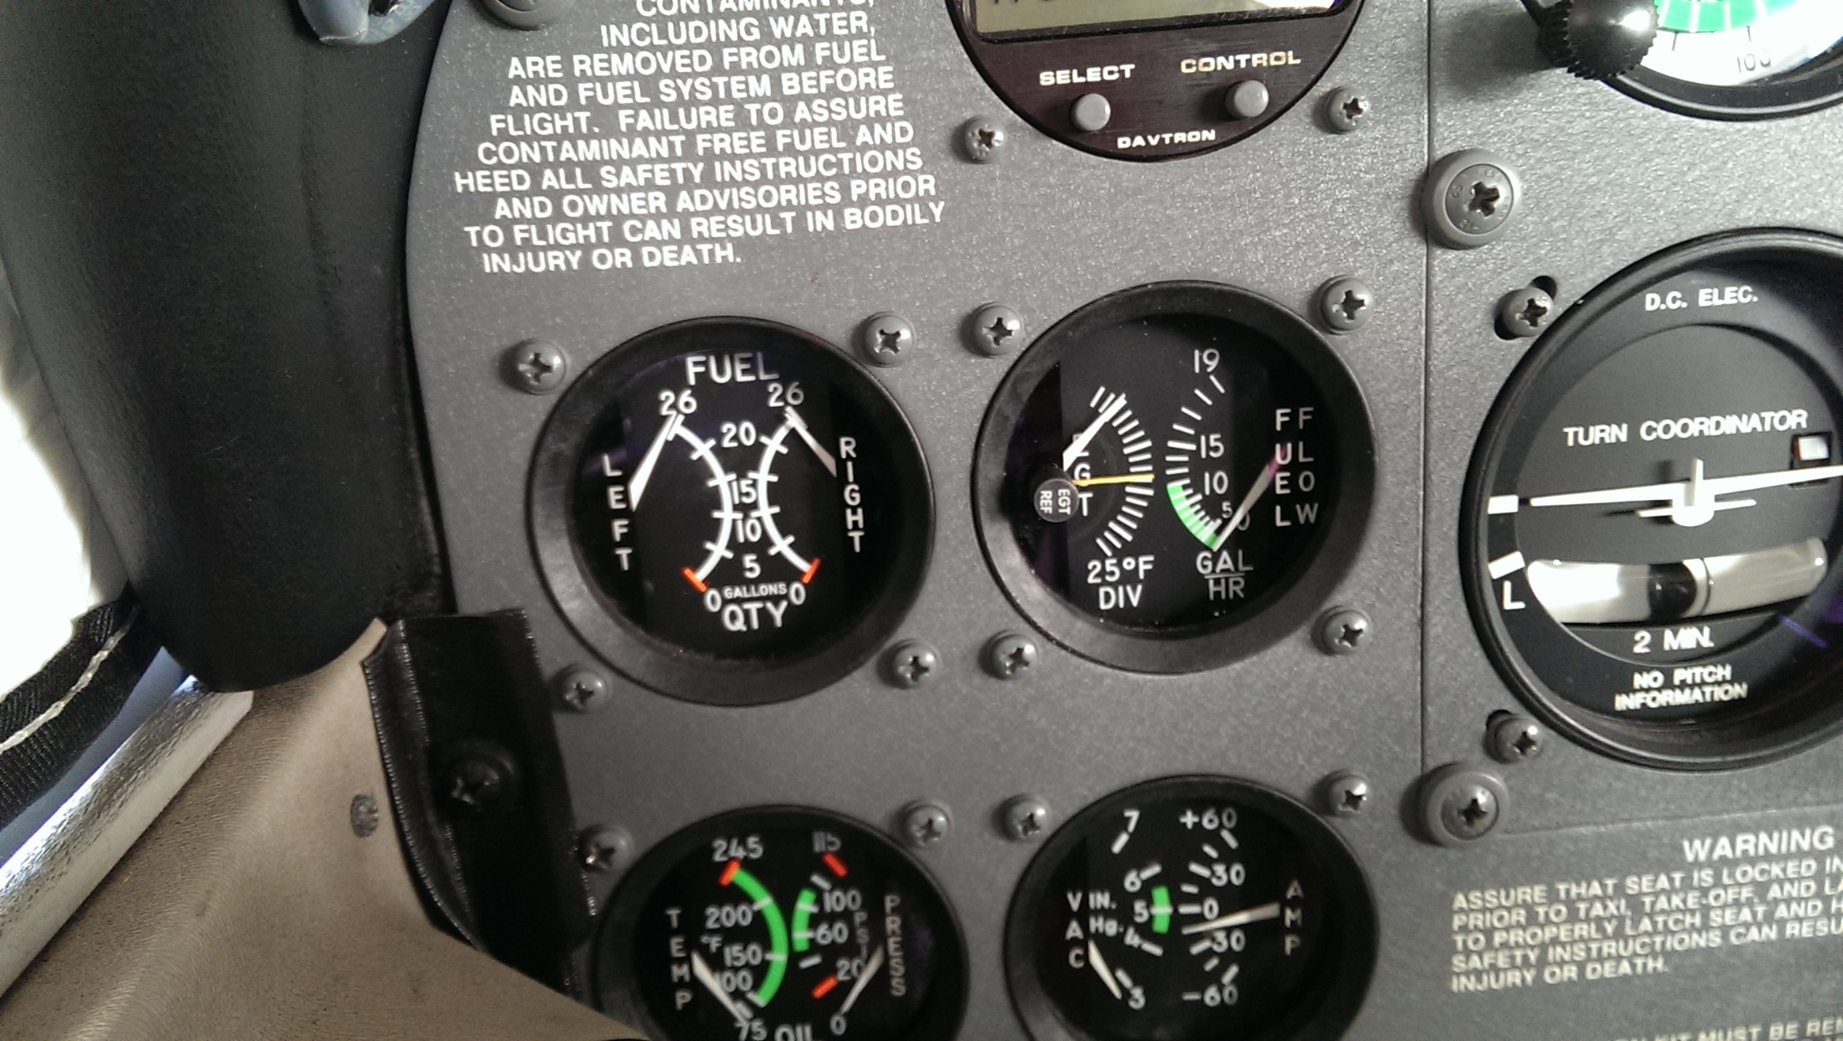
Some Examples of Aircraft Discrepancies
Does this aircraft have satisfactory instruments? Can we takeoff?

Slide 45
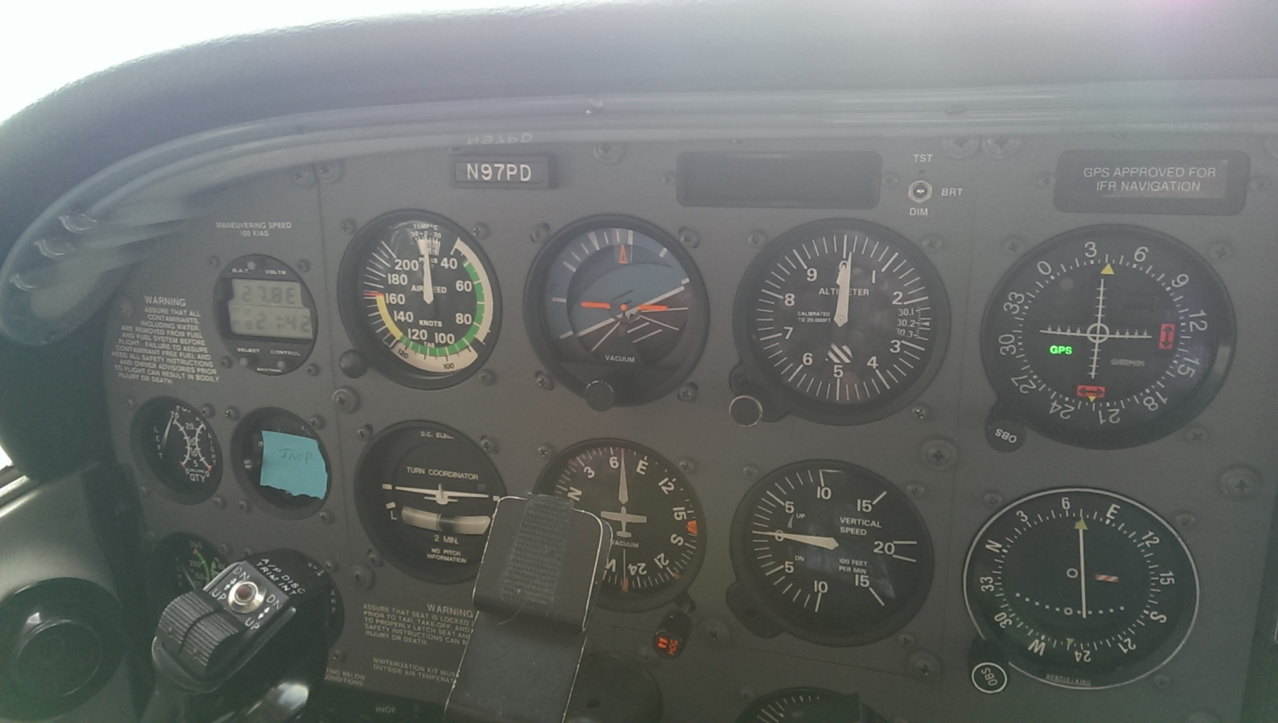
Some Examples of Aircraft Discrepancies
An example of an acceptable Deactivate and Placard of an Inoperative EGT/FF gauge

Slide 46
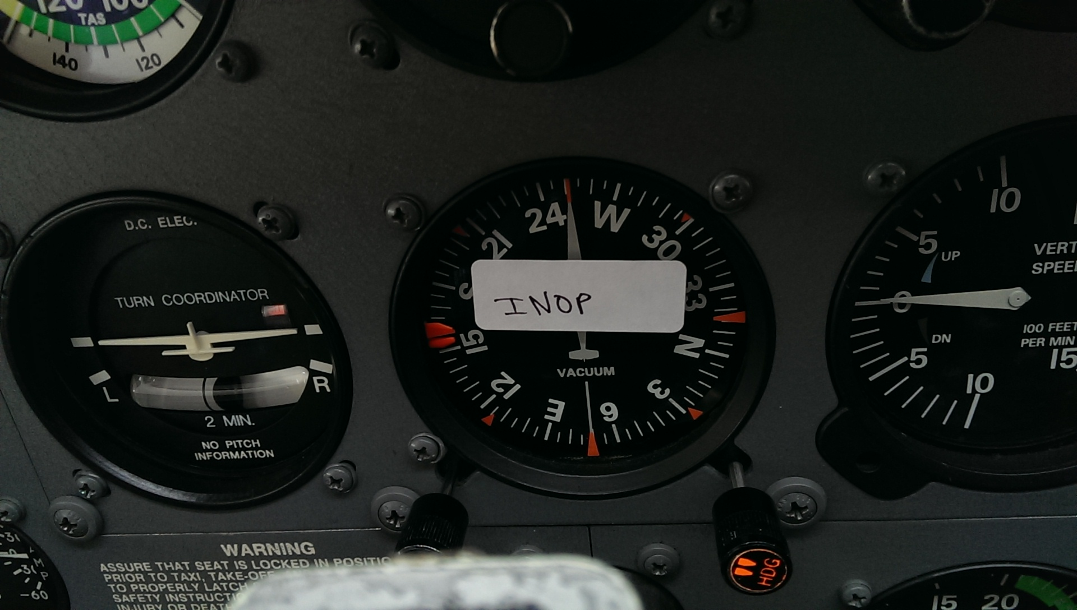
Some Examples of Aircraft Discrepancies
This inoperative DG has been Placarded. Has it been Removed or Deactivated?

Slide 47
Some Examples of Aircraft Discrepancies
This is a C172.
Can the pilot takeoff with this apparent electrical system problem, say for a flight from KBFI to KRNT where repairs can be made?

Slide 48
Some Examples of Aircraft Discrepancies
No, this C172 is not eligible for takeoff with inoperative equipment as the Alternator is listed in the Cessna equipment list as “Required” for VFR type certification.
Resolution was replacement of the voltage regulator.
If failure occurred in flight, landing at nearest suitable airport would be required.
If repairs could not be made at that airport, a Special Flight Permit would be required to relocate the aircraft.

Slide 49
Some Examples of Aircraft Discrepancies

Slide 50
Some Examples of Aircraft Discrepancies
There is no indication that the pilot met the requirement to Deactivate and Placard the inoperative equipment.
While the aircraft is likely safe for flight, such a flight could be subject to FAA enforcement action.

Slide 51
Some Examples of Aircraft Discrepancies
It this a good Pilot Resolution of this Discrepancy?

Slide 52
Some Examples of Aircraft Discrepancies
Pilot Resolution only addressed part of 91.213(d) requirements.
Was the Position light system placarded and deactivated?
A flight without full 91.213(d) compliance could be subject to FAA enforcement action.

Slide 53
Some Examples of Aircraft Discrepancies
This Pilot Resolution is much more complete and documents the pilot’s action and the applicable restrictions.

Slide 54
Inspection and Maintenance Requirement
The following tests and inspections are required:
No person may operate an aircraft unless…
  91.409 Annual Inspection (12 calendar months); 100 hours if operated for hire
  91.207 ELT Inspection (12 calendar months)
    ELT Battery must be replaced if activated for more than 1 hour, or at the date specified on the battery
  91.411 Altimeter and Altitude Reporting Equipment (“Pitot Static”) Inspection (24 calendar months) if operated IFR
  91.413 Transponder Inspection (24 calendar months) if transponder required
  91.171 VOR check (30 days) if VOR navigation is used under IFR
Inspections (some of which may be repetitive based on calendar time or operating time in service) are required when specified by any Airworthiness Directive

Slide 55
Compliance and Aircraft Records
All required inspections and tests must be documented in permanent aircraft maintenance records (logbooks) -- 43.11
“I certify that this aircraft has been inspected in accordance with [insert type] inspection and was determined to be an airworthy condition”
All maintenance performed must be documented in aircraft maintenance records (logbooks) – 43.9

Slide 56
Compliance and Aircraft Records – Pilot Responsibility
91.407 Operation after maintenance, preventive maintenance, rebuilding, or alteration
  (a) No person may operate any aircraft that has undergone maintenance, preventive maintenance, rebuilding, or alteration unless –
    It has been approved for return to service by a person authorized under 43.7 of this chapter; and
    The maintenance record entry required by 43.9 or 43.11 as applicable, of this chapter has been made.
  (b) No person may carry any person (other than crewmembers) in an aircraft that has been maintained, rebuilt, or altered in a manner that may have appreciable changed its flight characteristics or substantially affected its operation in flight until an appropriately rated pilot with at least a private pilot certificate flies the aircraft, makes an operational check of the maintenance performed or alteration made, and logs the flight in the aircraft records
  (c) The aircraft does not have to be flown if prior to flight, ground tests, inspection, or both show conclusively that…

Slide 57
Questions?
Howard Wolvington
ATP, Gold Seal CFI-CFII-MEI ASEL/ASES/AMEL
2014 National CFI of the Year
Designated Pilot Examiner
Email: Howard@FlyWithHoward.com
Cell: 425-761-4729

